Slide 1
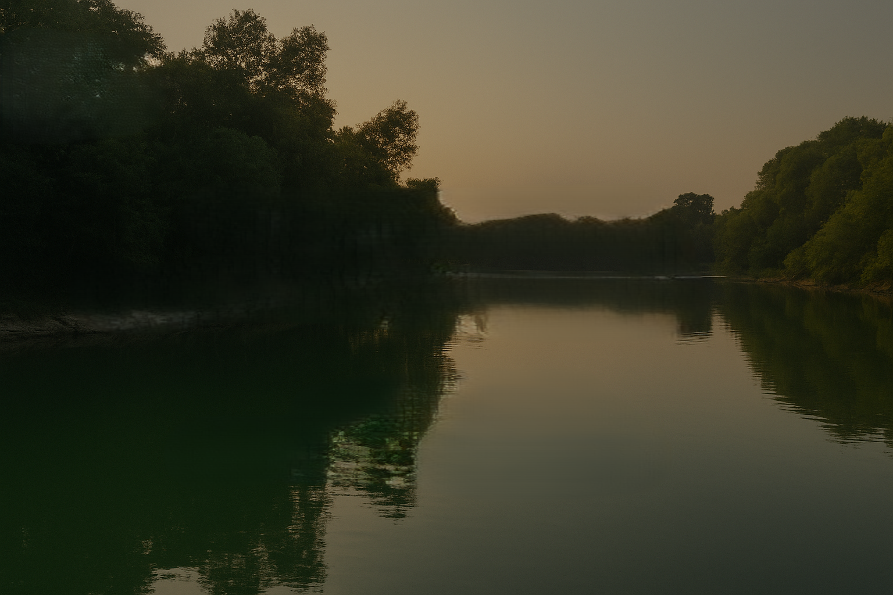


JHEEL SAATHI
Where Community Meets Science for Lake Care
By Team Abheet: Jatin Sinha and Samanshi Rohilla

Slide 2
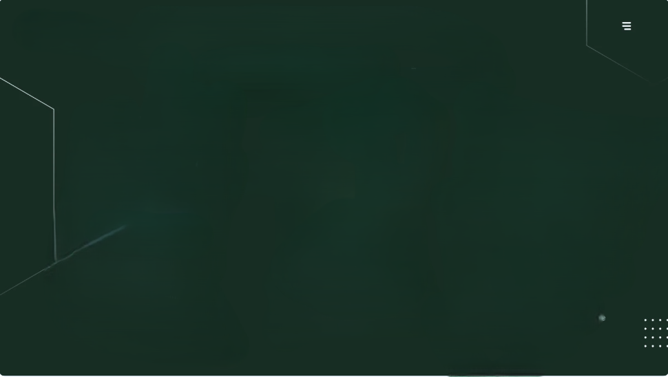
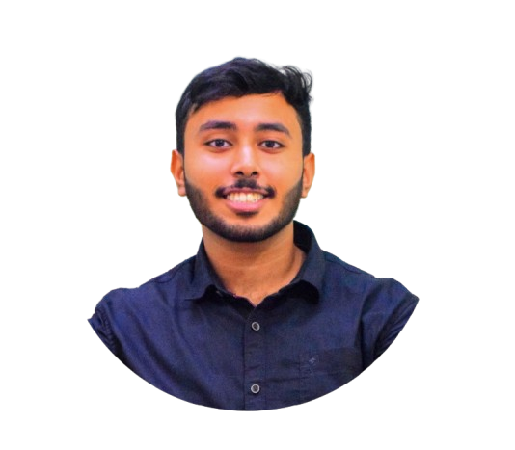
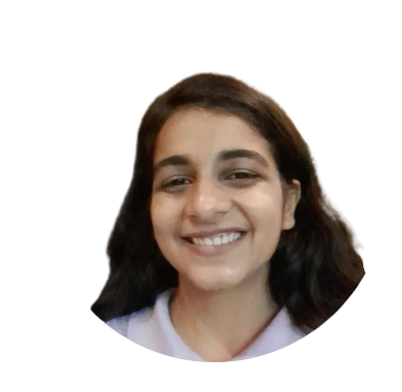
OUR TEAM
Jatin Sinha (B.Tech Bennett University): Technical Developer & Platform Design
Samanshi Rohilla (M.Sc. Environmental Studies): Research & Ideation

Slide 3





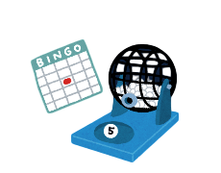

PROJECT OVERVIEW
READING MATERIAL
EDUCATION & AWARENESS, DATA AND RESEARCH, RESEARCH-DRIVEN ACTION
JHEEL SAATHI (Web based platform)
LAKE HEALTH REPORT
USERS
LAKES ON MAP
GAMIFIED ENGAGEMENT

Slide 4
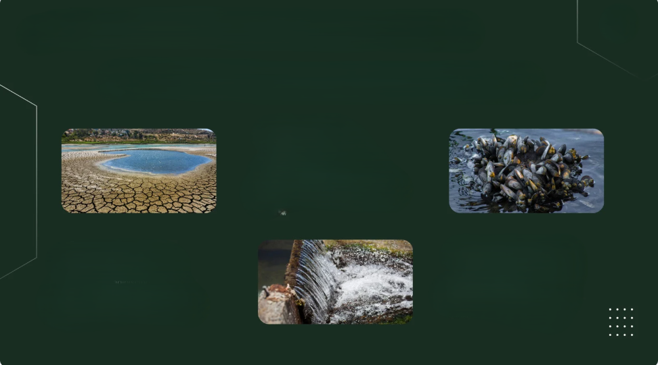
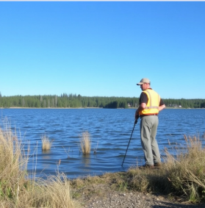
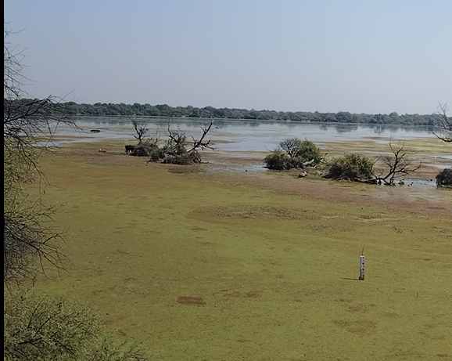
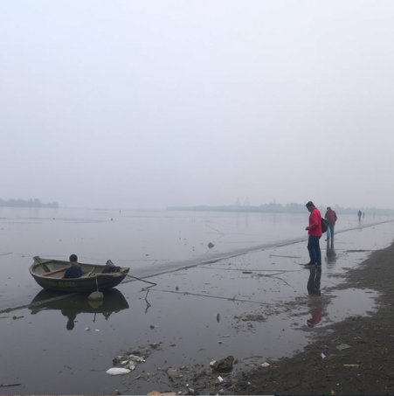
PROBLEM STATEMENT
LACK OF COMMUNITY INVOLVEMENT
LAKE DETERIORATION
LIMITED MONITORING

Slide 5
SOLUTION
🌐 Interactive Web-Based Platform – Accessible on any device for easy lake data entry and visualization based on a simple questionnaire. Users can mark surveyed lakes on maps, creating a community-driven geospatial database.
📊 Lake Health Report – Automatically generated, classifying lake health based on user inputs
📖 Educational Content – Reading material available.
👥 Community-Centered – Empowers students, local communities, and citizen scientists to observe, learn, and act.
🔗 Support for Research & Policy – Aggregated data helps researchers, NGOs, and government agencies plan interventions.

Slide 6

FEATURES
Mark and locate lakes on the map
Pre-marked Ramsar sites in India
AI-generated Lake health report along with recommendations and actionable measures based on user inputs
Report available for print
Leaderboards based on the number of lake assessments done
Quiz and leaderboard
Learning resources
Safety guide

Slide 7

INITIAL VISION VS FINAL SUBMISSION
Initial Plan | Final Submission
Largely focused on community engagement via data collection | Empowering the community through education and tools for conservation and restoration
Simple data entry, no strong visual features | Enabled marking and locating lakes on the map, and mapped Ramsar sites
Completely online mode | Added printable material (including assessment questionnaire) for school workshops and remote areas

Slide 8
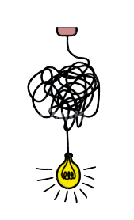
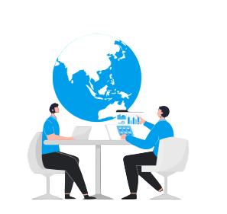
KEY LEARNINGS FROM CODE4NATURE
Collaboration & Interdisciplinary Thinking
Learning to simplify for everyone

Slide 9




PROJECT HIGHLIGHTS
Citizen Science Made Simple
Interactive platform
Integrated Environmental Education
Scalable

Slide 10
NEXT STEPS: SUSTAINABILITY BEYOND CHALLENGE
Platform Refinement and Testing; Developing science-backed questionnaires to ensure accurate lake health reports → Scalable Citizen Science Network
Team & Network Expansion, and Partnerships → Partnership-Driven Growth
Community Outreach & Partnerships → Community Engagement & Ownership

